Slide 1
Unit-V
Cloud Security

Slide 2
Cloud Security
A healthy cloud ecosystem is desired to free users from abuses, violence, cheating, hacking, viruses, rumors, pornography, spam, and privacy and copyright violations.
The security demands of three cloud service models, IaaS, PaaS, and SaaS, are described in this unit.
These security models are based on various SLAs (Service Level Agreement) between providers and users.

Slide 3
Three basic cloud security enforcements are expected.
First, facility security in data centers demands on-site security year round. Biometric readers, CCTV (close-circuit TV), motion detection, and man traps are often deployed.
Network security demands fault-tolerant external firewalls, intrusion detection systems (IDSes), and third-party vulnerability assessment.
Finally, platform security demands SSL and data decryption, strict password policies, and system trust certification.

Slide 4
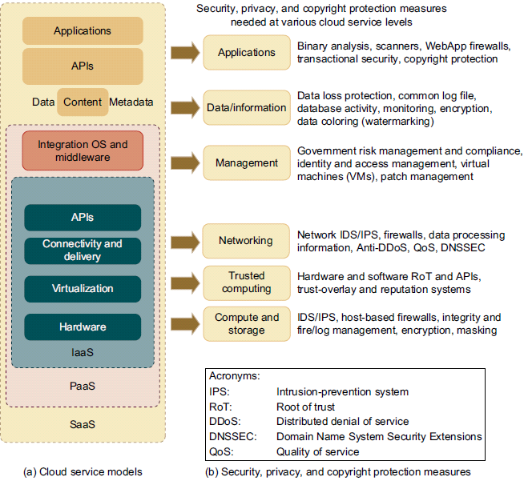
Figure shows the mapping of cloud models, where special security measures are deployed at various cloud operating levels.

Slide 5
Thus, security defenses are needed to protect all cluster servers and data centers.
Here are some cloud components that demand special security protection:
  Protection of servers from malicious software attacks such as worms, viruses, and malware
  Protection of hypervisors or VM monitors from software-based attacks and vulnerabilities
  Protection of VMs and monitors from service disruption and DoS attacks
  Protection of data and information from theft, corruption, and natural disasters
  Providing authenticated and authorized access to critical data and services

Slide 6
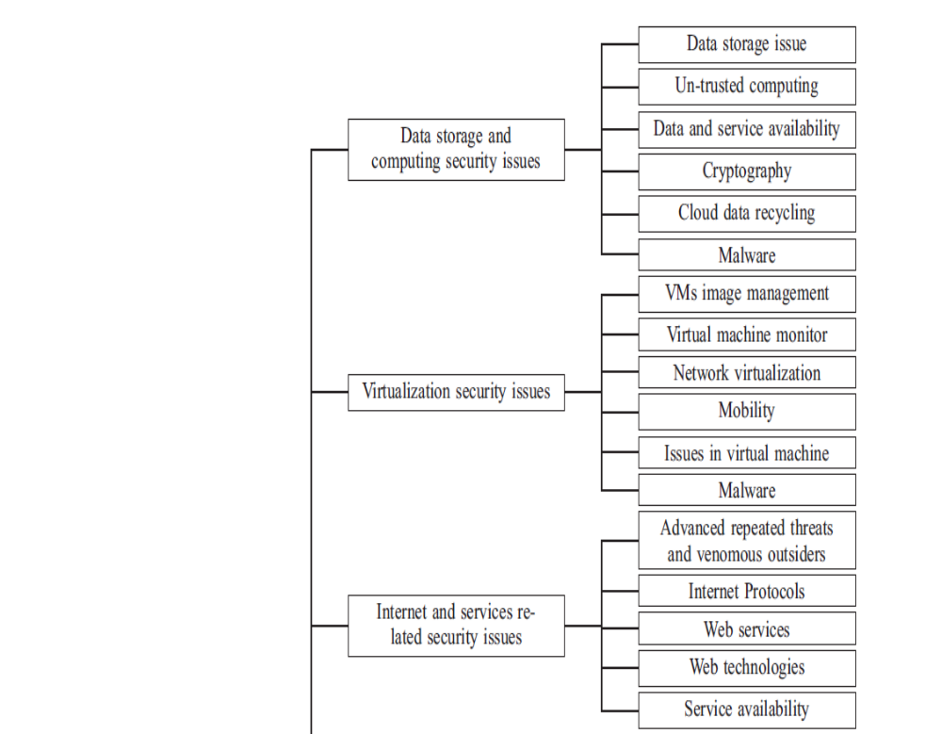
Current state of Cloud Security Issues
Notes:
Ashish Singh, Kakali Chatterjee, Cloud security issues and challenges: A survey, Journal of Network and Computer Applications 79 (2018) 88–115

Slide 7
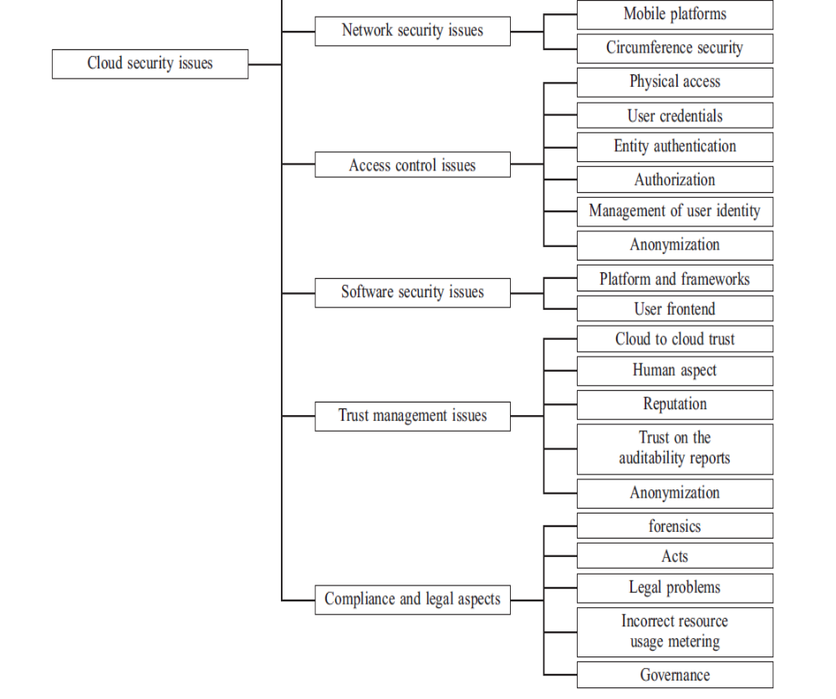


Slide 8
Cloud Security
Mandatory Software properties for making data secure!!
Dependability: Under any conditions like attack, infections
Trustworthiness: Minimum Vulnerabilities
Survivability: Tolerant with little harm – Graceful degradation
CIA Triad (confidentiality, integrity, and availability) : We don’t want DAD (Disclosure, Alteration, Destruction)
Confidentiality: IPR, Covert channels, Traffic analysis, Encryption, Interference
Integrity: Modifications
Availability: 99.99%

Slide 9
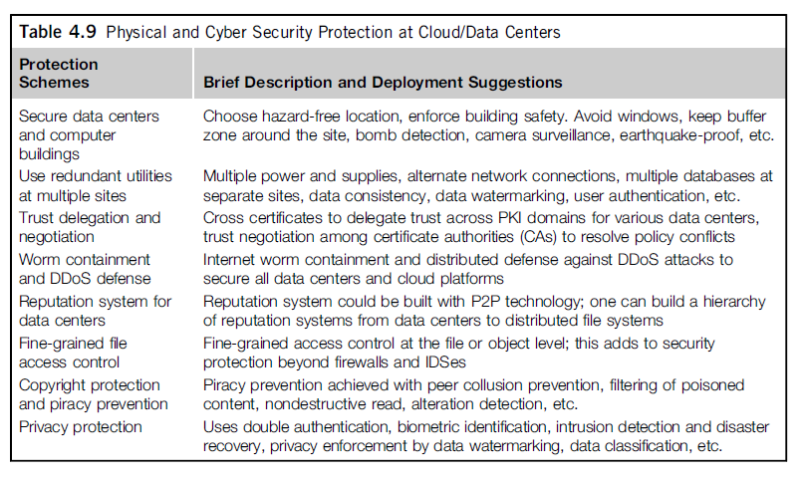
Cloud Defense Methods

Slide 10
Defense with Virtualization
The VM is decoupled from the physical hardware. The entire VM can be represented as a software component and can be regarded as binary or digital data.
The VM can be saved, cloned, encrypted, moved, or restored with ease. VMs enable HA and faster disaster recovery.
Live migration of VMs was suggested by many researchers [36] for building distributed intrusion detection systems (DIDSes).
Multiple IDS VMs can be deployed at various resource sites including data centers.
DIDS design demands trust negation among PKI domains. Security policy conflicts must be resolved at design time and updated periodically.

